Slide 1
Examining the Effects of Worldwide Health Crisis on Public Health and Economic Stability
CSCE 5320 SCIENTIFIC DATA VISUALIZATION
GROUP-22

Slide 2
Introduction
The crisis had a dramatic impact on global poverty and inequality. Global poverty increased for the first time in a generation, and disproportionate income losses among disadvantaged populations led to a dramatic rise in inequality within and across countries.
The outbreak of Covid-19 resulted in a lot of restrictions which resulted in so many impacts on the global economy. Almost all countries were impacted negatively by the rise in the cases of Covid-19.
This project's domain includes the connection between public health outcomes, economic stability, and global health problems. The complicated relationships between numerous elements, such as pandemics, economic indicators, and public health regulations, are examined in this multidisciplinary topic.
Beyond just harming public health, health crises like the COVID-19 pandemic have a big impact on society and the economy. For example, the airline sector has been severely damaged by travel bans, decreased passenger demand, and operational difficulties brought on by measures to stop the spread of infectious diseases.

Slide 3
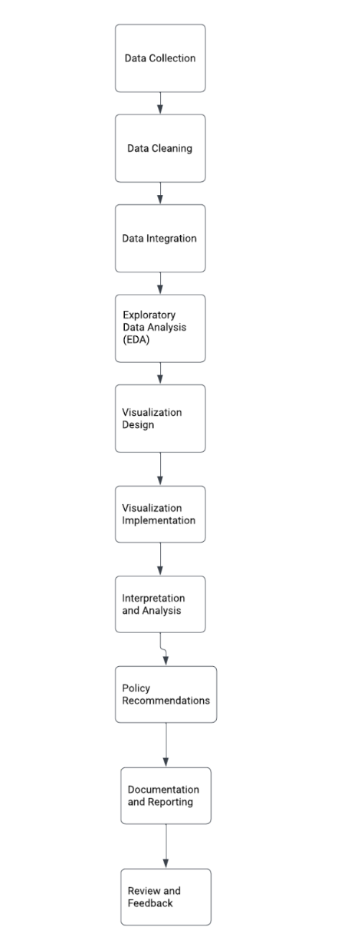
Workflow

Slide 4
Data Abstraction
We have used 4 datasets in our implementation and data visualization.
owid-covid-data.csv(166327 records)
countries-table.csv(235 records)
raw_data.csv(50419 records)
transformed_data.csv(50419 records)
We have downloaded all this datasets from Kaggle (data collection)
The datasets we have downloaded required no further cleaning and tranformation

Slide 5
Task Abstraction
Our main task is to visualize the financial effects of Covid in all the countries.
After visualizing the major countries with financial effects, we have checked common qualities in such countries such (density of population)
We have also visualized countries with highest population in the world.
We have also visualized countries with highest no of cases and death due to Covid 19 in the world.

Slide 6
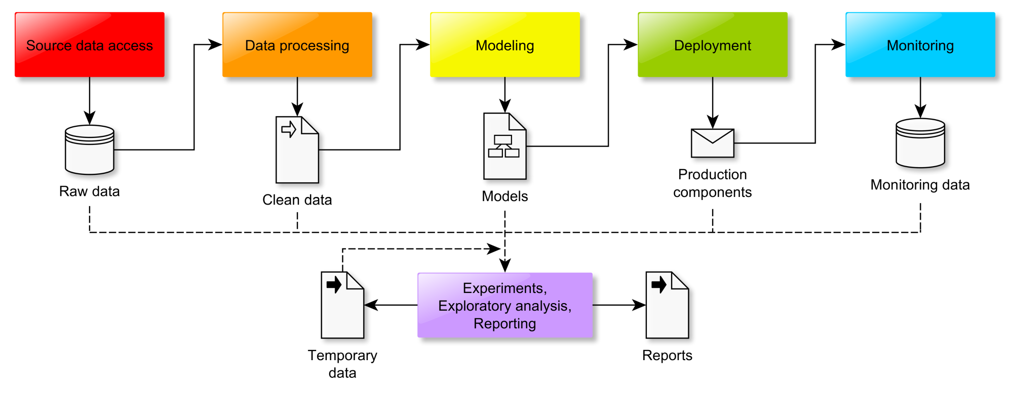
Task Abstraction WorkFlow

Slide 7
Implementation using Tools
The main tool used for this project is Google Colab this is where we have done all our coding in python and visualizations.
For many graph visualisations we have used Matplotlib and Seaborn library.
And for the bar graph representation we have used plotly.js
For the graph which represent spread of covid and effects we have used D3.js visualization tool with interactive interface.

Slide 8
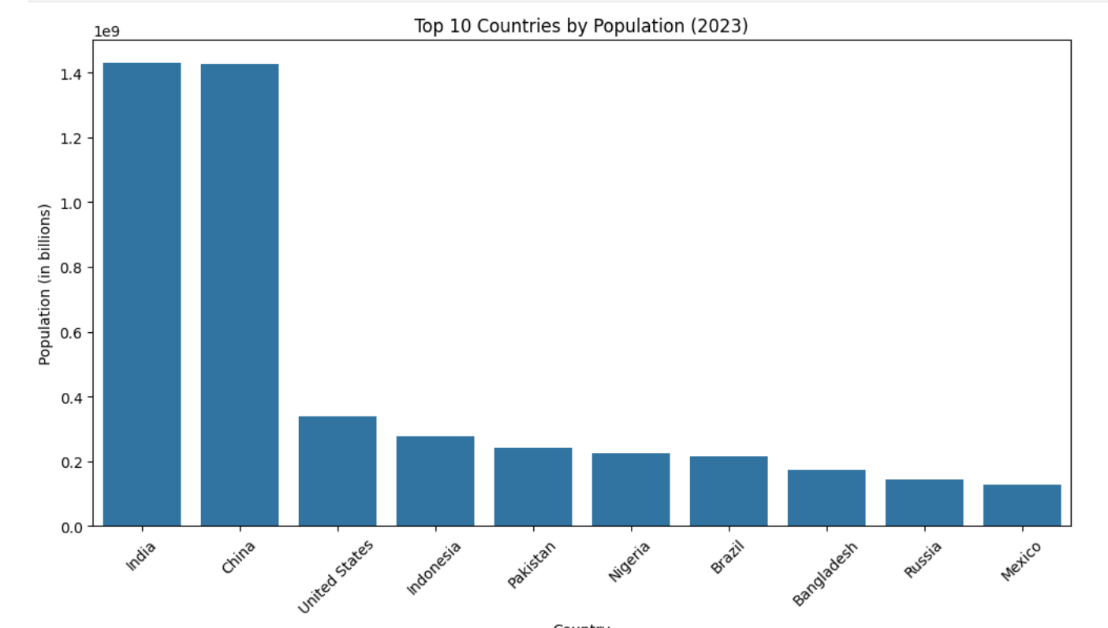
Plotting top 10 most populated countries (according to 2020)

Slide 9
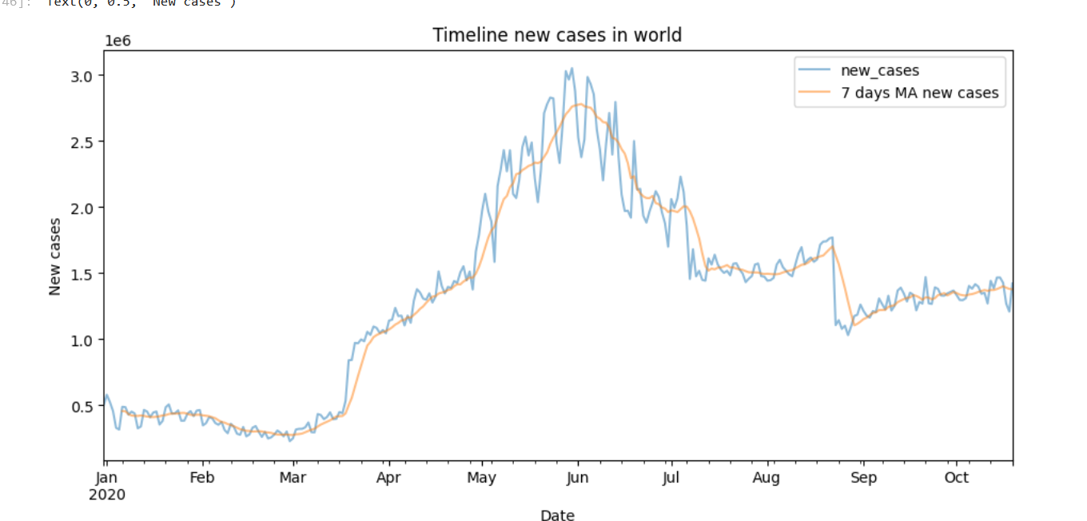
Visualization of New covid cases in the world between January 2020 and October 2020

Slide 10
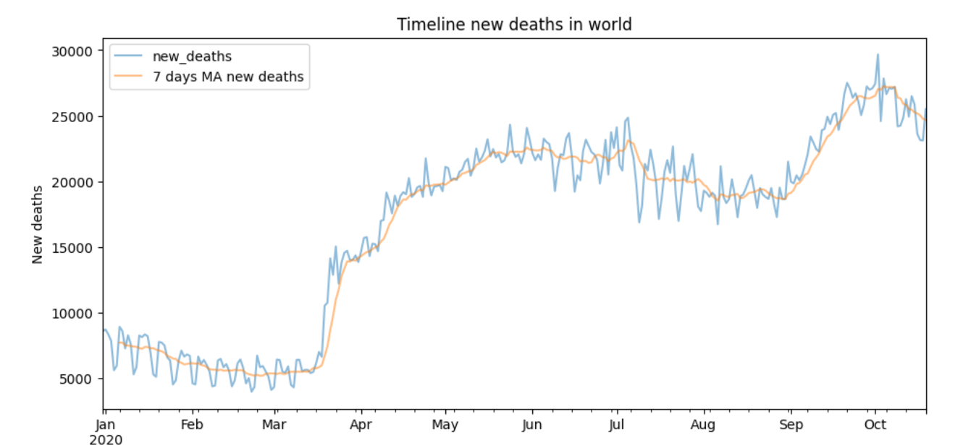
Visualization of New covid cases in the world between January 2020 and October 2020

Slide 11
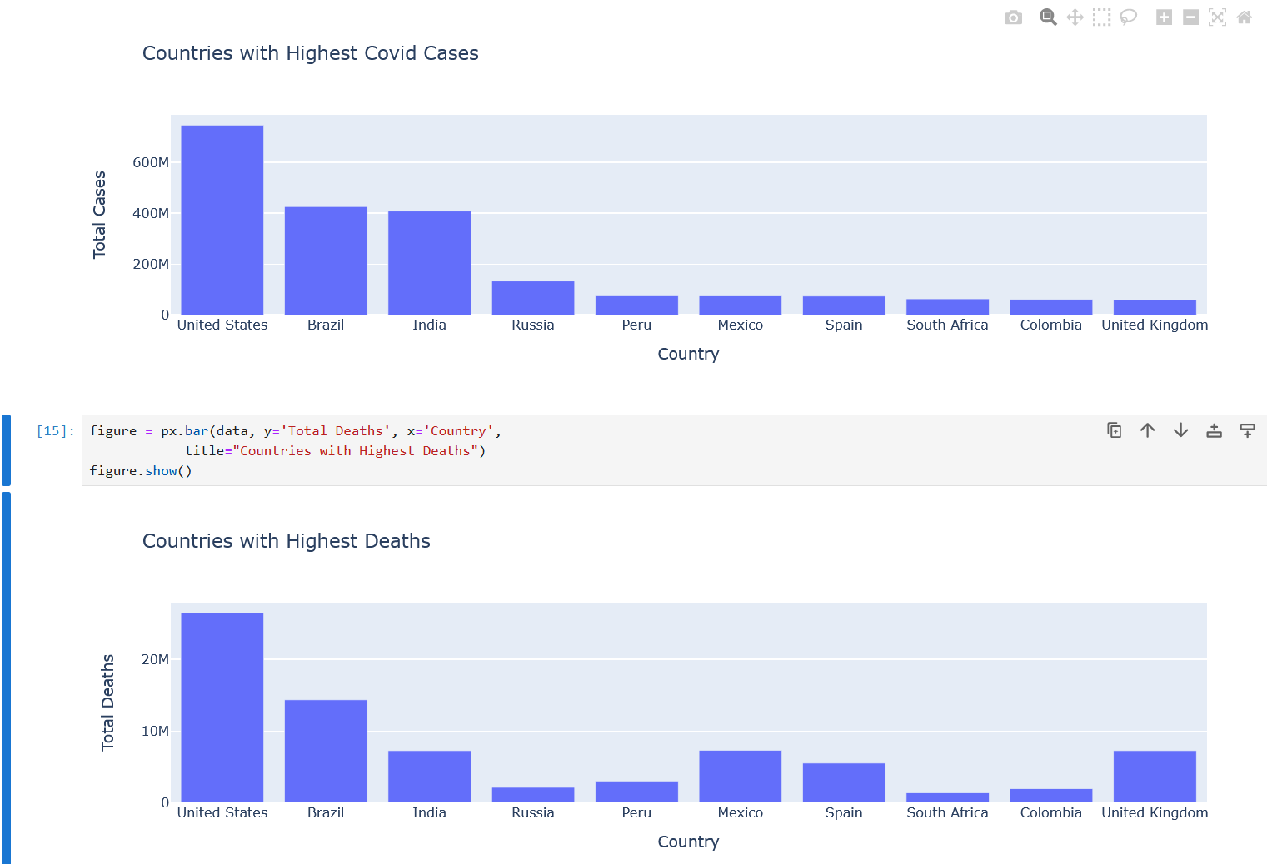
Countries with highest death due to Covid-19 at the start of 2020

Slide 12
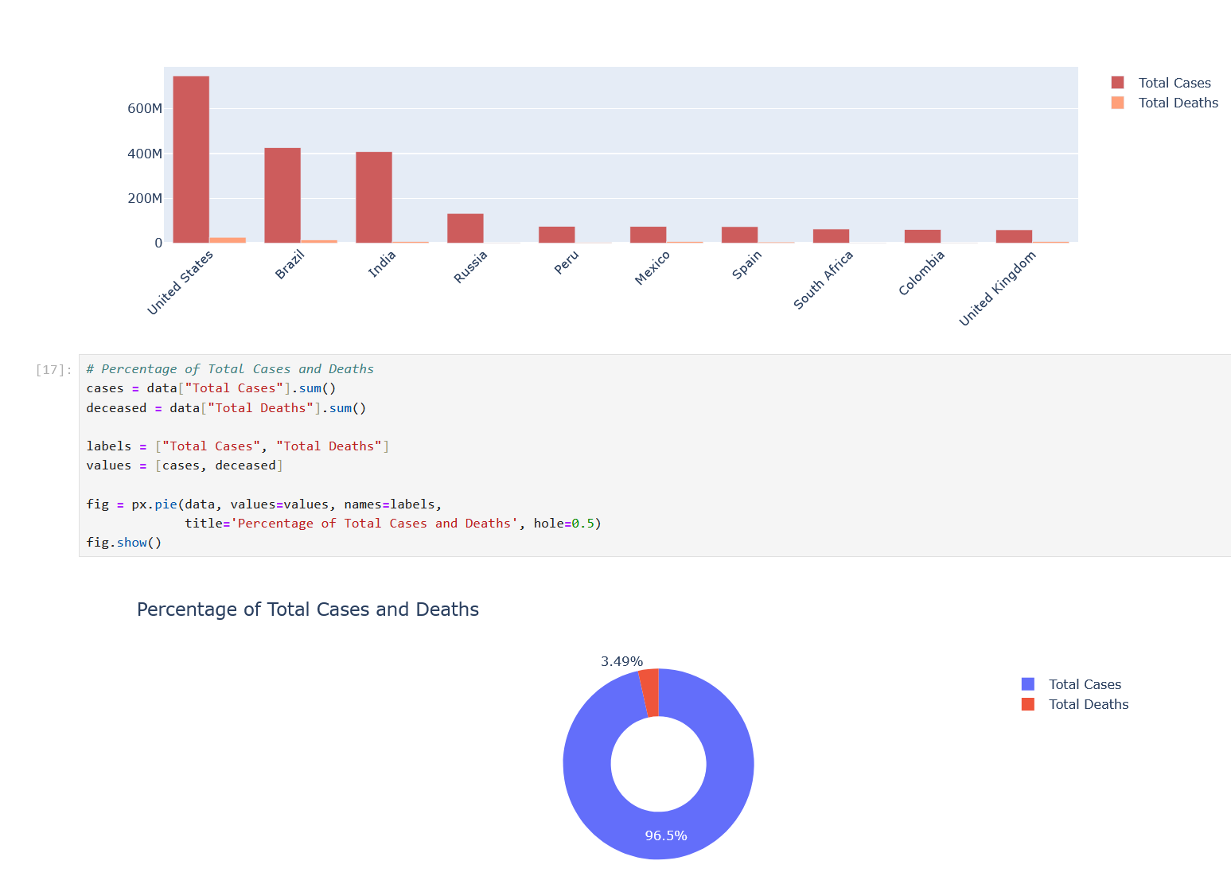
Comparison of total cases to deaths of Covid-19

Slide 13
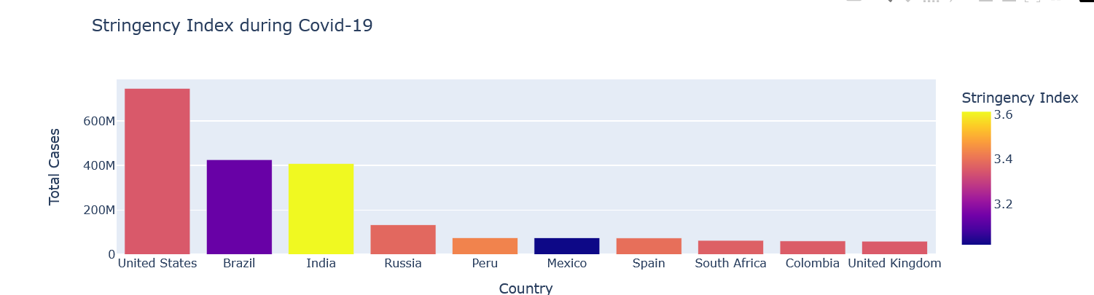
Number of Measures taken by each country to prevent covid 19

Slide 14
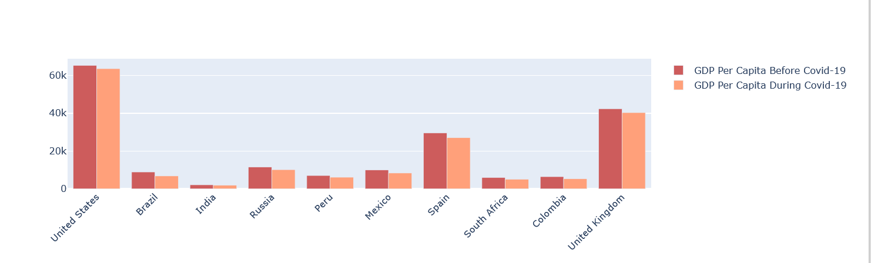
Comparing before and after Financial Effects of Covid-19

Slide 15
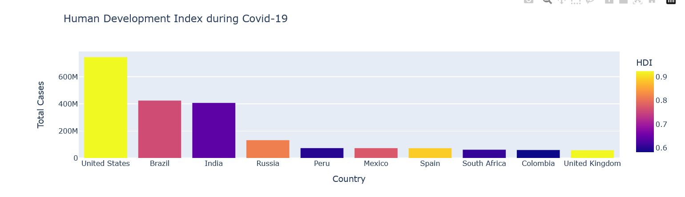
Human Development Index

Slide 16
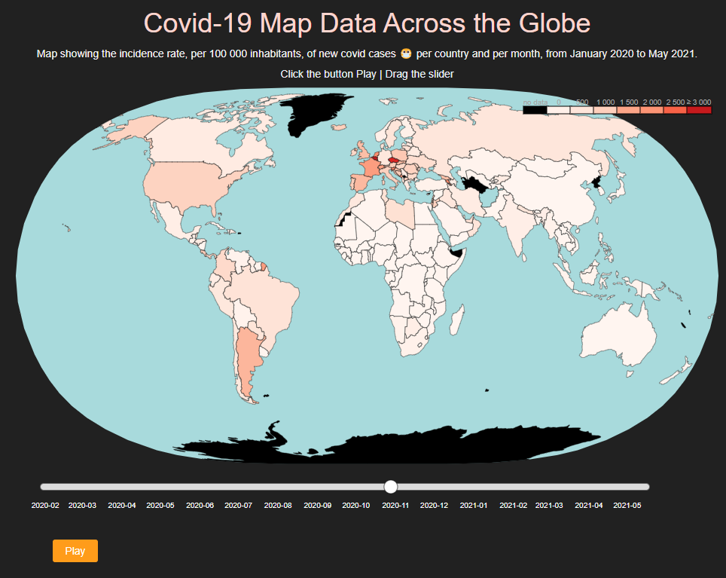
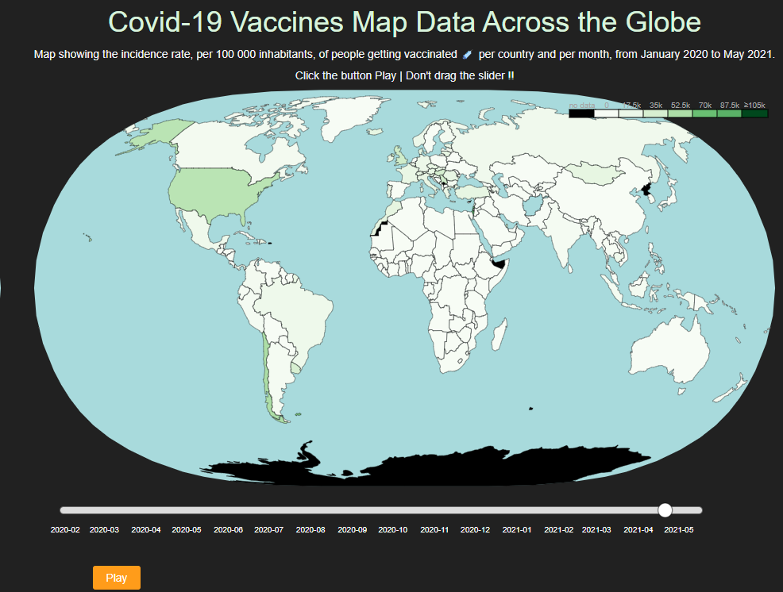
Analysis spread and vaccines of covid 19 using D3.js and CSS
VizHub Link:
https://vizhub.com/Haneesh-Reddy/8a168947f751405dac40c85ab027b305?edit=files

Slide 17
Project Management
Haneesh- Role: Project idea and Initial Data Preparation. Responsibilities: Haneesh is responsible for pre-analytical handling of the data, ensuring that it is properly cleansed, and appropriately formatted for further analysis.
Dinesh- Role: Data Analysis Responsibilities: Dinesh acts in the role of the analyzer. He subjects data to statistical methods of interpretation to derive some meaningful patterns or insights.
Tarun- Role: Data Visualization Responsibilities: Tarun would be responsible for data visualization into various forms of charts and graphs for better access and understanding in the specified format.
Harshith- Role: Data Modelling Responsibilities: Harshith specializes in complex data modeling such as time series and forecasting analyses of COVID-19 case progressions.

Slide 18
References
Allam, Z., & Jones, D. S. (2020). On the Coronavirus (COVID-19) Outbreak and the Smart City Network:Universal Data Sharing Standards Coupled with Artificial Intelligence (AI) to Benefit Urban Health Monitoring and Management. Healthcare, 8(1), 46. [DOI: 10.3390/healthcare8010046]
IATA. (2021). COVID-19 and the Air Cargo Industry. International Air Transport Association. Retrieved from https://www.iata.org/en/programs/cargo/covid19/
World Bank. (2021). COVID-19 Crisis Through a Migration Lens. World Bank. Retrieved fromhttps://www.worldbank.org/en/topic/labormarkets/brief/migration-and-development-brief-35-covid-19-crisis-through-a-migration-lens
European Centre for Disease Prevention and Control (ECDC). (2021). COVID-19 situation update worldwide. European Centre for Disease Prevention and Control. Retrieved fromhttps://www.ecdc.europa.eu/en/geographical-distribution-2019-ncov-cases
ICAO. (2020). Economic impact of COVID-19 on civil aviation. International Civil Aviation Organization.Retrieved from https://www.icao.int/sustainability/Pages/Economic-impact-of-COVID-19.aspx

Slide 19
THANK YOU

